Slide 1
Comparison of conventional and modern CNC technologies
Barbara Ciecińska
Przemysław Podulka
Rzeszow University of Technology

Slide 2
Case Study 1: The design of Technological Process (TP)
Case Study 2: Technological process design. Comparative analysis of the use of conventional and CNC machine tools
Case Study 3: Laser cutting of plastics
‹#›
Notes:
‹#›

Slide 3
Case Study 1:
The design of Technological Process (TP)
‹#›
Notes:
‹#›

Slide 4
Production process and technological process: Introduction
The production process – is the entirety of activities aimed at transforming a human idea into a finished product.
Technological process – is a part of the production process, directly related to the change of shape, dimensions, surface quality and properties of individual machine parts. This is called technological process of the part.
Technological process – may involve combining these parts into a single whole, an assembly. We are talking then about the technological process of assembly.
*
Comparison of conventional and modern CNC technologies
4/80

Slide 5
Production process and technological process: Introduction
The TP of a part is an ordered and logical sequence of activities aimed at giving the input material its final form.
The sequence of actions is expressed by the so-called operations, treatments, locations carried out on the subject.
The workpiece is properly positioned in the machining zone, fixed or not, oriented with respect to the tool and working movements.
This sequence is expressed in the form of the structure of the TP.
*
Comparison of conventional and modern CNC technologies
5/80

Slide 6
Production process and technological process: Introduction
The structure of TP
Technological process
Operations
Operation 1
Operation 2
Operation 3
Operation n
Locating 1
Position 1
Locating 2
Position 2
Locating n
Position n
Cuts
Cut 1
Cut 2
Cut 3
Cut n
Path 1
Path 2
Activities
Path n
Therbligs
*
Comparison of conventional and modern CNC technologies
6/80

Slide 7
Production process and technological process: Introduction
Operation – is a part of the process including all activities performed on a specific part by one employee or one team, on one workstation, with one set of equipment, without interruptions for other works.
The special feature:
constant:
the workpiece
workstation
performer
*
Comparison of conventional and modern CNC technologies
7/80

Slide 8
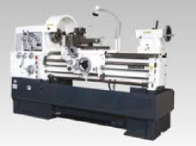
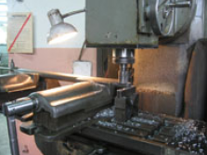
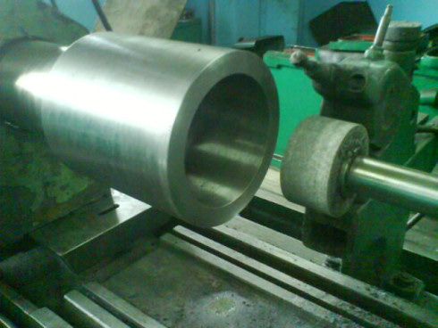
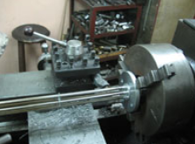
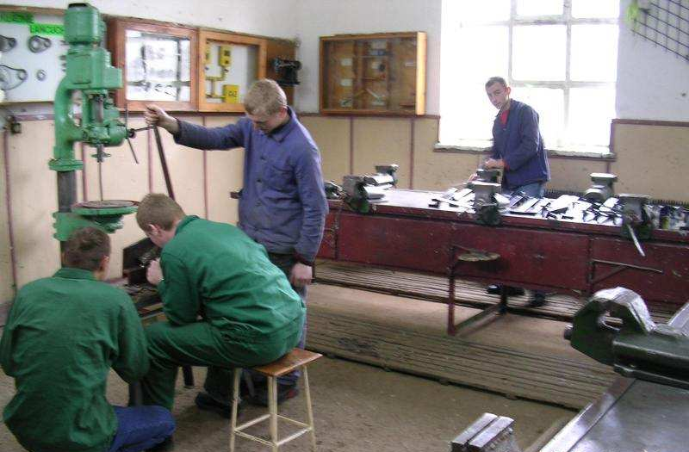
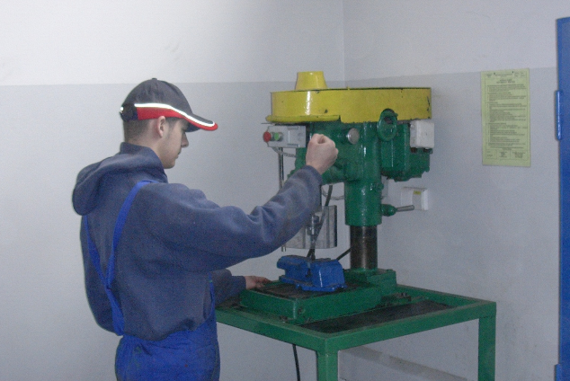
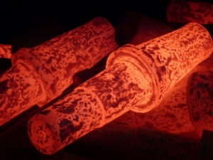
Production process and technological process: Examples of Technological Operations
turning
milling
grinding
locksmith
drilling
heat treatment
*
Comparison of conventional and modern CNC technologies
8/80

Slide 9
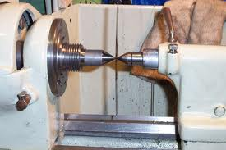
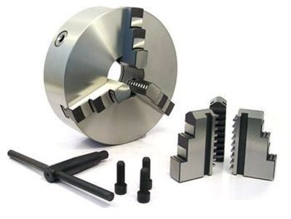
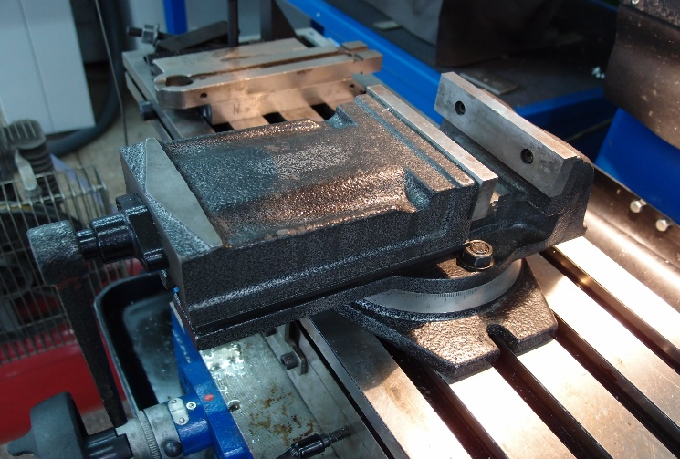
Locating (Mounting)
Locating (mounting) – Part of an operation performed with a single workpiece clamping, when appropriately directed forces are applied to the workpiece to fix it during machining.
In a vice
In the centers of the lathe
In a three-jaw chuck
*
Comparison of conventional and modern CNC technologies
9/80

Slide 10
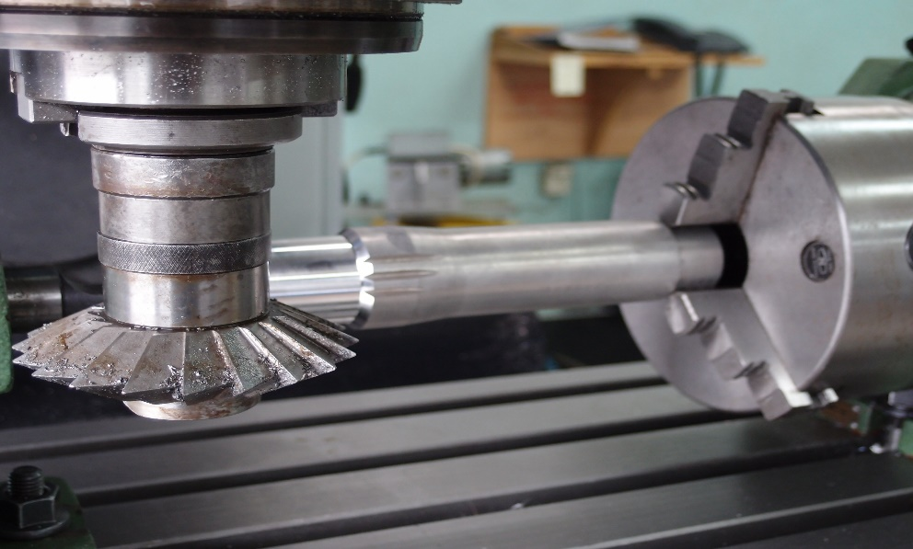
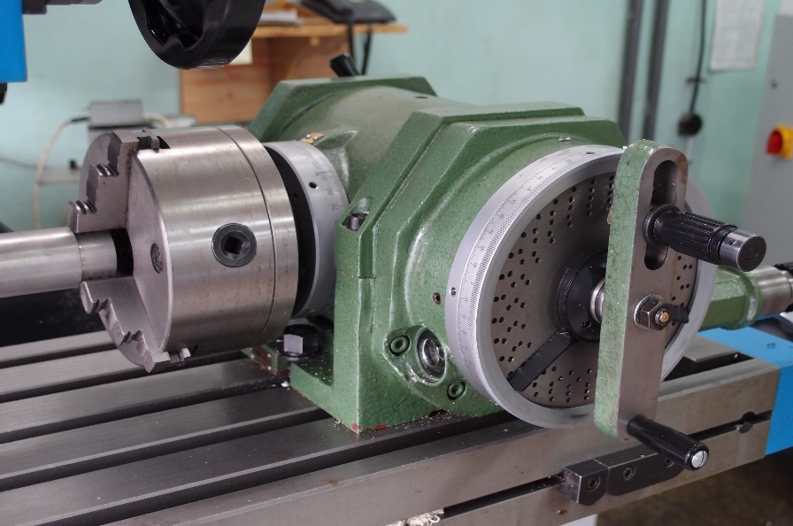
Position
The position of an object mounted in the jig or on a turntable in one fixture (set-up).
Change of position is achieved without unfastening the workpiece.
An example of changing the position in the three-jaw chuck of the dividing head of milling machine
*
Comparison of conventional and modern CNC technologies
10/80

Slide 11
Cut
Cut is a part of an operation that changes the shape, dimensions, roughness, mechanical properties, or physical condition of an object in whole or in part.
Constant:
- Surface;
- Tools or devices;
- Processing parameters specific to a given process
(cutting speed, heating temperature, etc.).
*
Comparison of conventional and modern CNC technologies
11/80

Slide 12
Cut
The cut (treatment) takes place when the following are processed:
- one surface with one tool - this is a simple cut
- a set of surfaces with a set of tools - it is a complex cut
with fixed parameters.
Simple cut
Complex cut
*
Comparison of conventional and modern CNC technologies
12/80

Slide 13
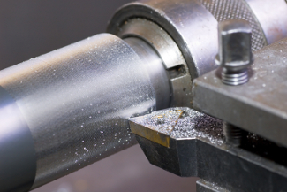
Path
The part of the operation in which one layer of material is removed.
If there is only one path - it will also be a cut.
Removing of material:
1 layer = 1 path
*
Comparison of conventional and modern CNC technologies
13/80

Slide 14
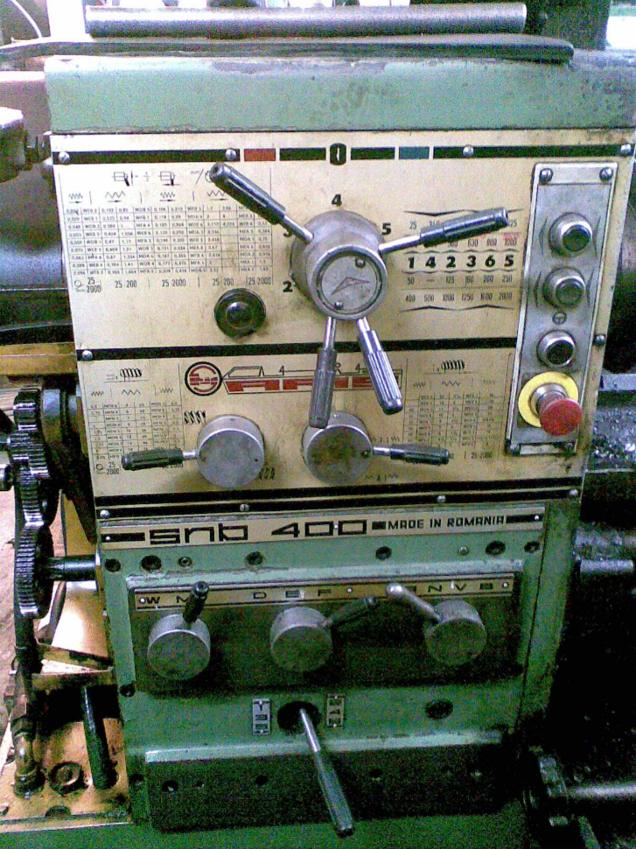
Activity
Part of an operation or cut that is a separate activity for performing a specific task.
Example:
starting the machine - pressing a button
turning on the spindle rotation
switching on the feed
*
Comparison of conventional and modern CNC technologies
14/80

Slide 15
Therblig
The smallest component of an activity that can be clearly defined with one task.
Example:
Activity - changing the rotation of the lathe
↓
Therblig 1 – grasping the lever
Therblig 2 – pushing it into the correct position
*
Comparison of conventional and modern CNC technologies
15/80
Notes:
‹#›

Slide 16
Modifications in the TP
There are changes in the technological process of parts:
1) shape and dimensions due to plastic working
2) shape and dimensions as a result of machining, erosive, etc.
3) mechanical properties as a result of heat or thermo-chemical treatment
4) quality of the surface and the condition of the top layer as a result of surface finishing
*
Comparison of conventional and modern CNC technologies
16/80

Slide 17
The structure of the TP of machining
The structure of the technological process of machining is a specific sequence of operations in this process.
The general technological process includes:
- Preliminary operations – cutting, straightening
- Execution of the machining base (bases) for further operations
Roughing – removing the largest possible volume of unnecessary material, providing relatively even allowances for further operations; large depths of cut, high feeds; workshop tolerance IT12-IT14;
Ra = 10-40 μm
*
Comparison of conventional and modern CNC technologies
17/80
Notes:
‹#›

Slide 18
The structure of the TP of machining
The structure of the technological process of machining is a specific sequence of operations in this process.
The general technological process includes:
- Shaping treatment - giving a shape similar to the finished one, allowances left only on the surfaces for finishing; IT9-IT11 tolerance; Ra = 2.5-5 μm
- Heat or thermo-chemical treatment
Finishing - grinding, fine turning or boring, fine milling; IT5-IT8 tolerance; Ra = 0.63 μm
Fine machining - high accuracy up to IT1, e.g. lapping, honing, polishing, burnishing Ra even 0.16-0.01 μm
Quality control - final (if after technical operation - intermediate)
*
Comparison of conventional and modern CNC technologies
18/80
Notes:
‹#›

Slide 19
The difficulties
It is characteristic to gradually give shape, accuracy, dimensions to the workpiece.
The difficulties include:
- geometric errors of the blank
- limited stiffness of the o-u-p-n system
- elastic and plastic deformation of the surface layer of workpiece
- thermal deformation
- wear of the tool and machine tool componentsa
*
Comparison of conventional and modern CNC technologies
19/80
Notes:
‹#›

Slide 20
Decisions which must be done
You should pay attention to the legitimacy of the choice:
conventional or CNC machine tools, machining centers, automatic machines
the place and sequence of the base correction operations
correction operations after heat, thermo-chemical treatment
place of heat, thermo-chemical treatment due to the limitation of hardness
*
Comparison of conventional and modern CNC technologies
20/80
Notes:
‹#›

Slide 21
Rules for planning of the operations
Rules for planning operations:
1) Select base surfaces and execute them first. Strive for invariability of the bases.
2) Determine type and dimensions of semi-finished product. Select allowance.
3) Select surfaces with large allowances as a first step. Removal of large allowances involves deformation of the part (due to inherent stresses and cutting forces) that can be removed in subsequent machining operations. It also allows sub-surface defects to be discovered early in the process (these may cause the part to be withdrawn from further machining). Significant clamping forces can be applied and any damage to the workpiece can be removed in subsequent machining operations.
4) Low accuracy and higher roughness surfaces are machined in the first operations.
*
Comparison of conventional and modern CNC technologies
21/80

Slide 22
Rules for planning of the operations
Rules for planning operations:
5) Pre-machine those surfaces that are finished at the end of the process.
6) Roughing, shaping and finishing are separated - different clamping forces, machining parameters, stiffness, machine power, etc.
7) Machining of low-precision surfaces is not separated according to 6)
8) Consider the advisability of concentrating or differentiating operations.
CONCENTRATION - machining of the maximum possible number of surfaces in a given operation (unit and mass production).
DIVERSIFICATION - planning of simple (non-complex) operations with frequent change of products produced in batches (serial production). Each operation should be possible to carry out without changing the setting of the machine tool and without changing the tooling.
*
Comparison of conventional and modern CNC technologies
22/80

Slide 23
Rules for planning of the operations
Rules for planning operations:
9) The location of the heat treatment shall be justified by its intended use:
Improving machinability (reducing hardness, removing structural inhomogeneities) - before treatment (softening annealing, normalising, quenching).
Stress reduction or removal - before or after roughing (stress relieving annealing, normalising, stabilising)
Removal of structural inhomogeneities - before treatment (stress relief annealing).
Improving strength properties (hardness, wear resistance, toughness) - through hardening or surface hardening with low, medium or high tempering, thermochemical treatment such as carburising, nitriding, cyaniding.
*
Comparison of conventional and modern CNC technologies
23/80

Slide 24
Rules for planning of the operations
Rules for planning operations:
9) The location of the heat treatment shall be justified by its intended use:
In case of through hardening, there is usually considerable distortion of the parts - before finishing, improvement by grinding, straightening and sanding.
With surface hardening such high stresses do not occur - before finishing grinding.
Carburizing with hardening - after fine machining and before grinding.
If the surface is protected against carburizing by copper plating - before grinding, if protected by an allowance - after carburizing the allowance is removed and the surface hardened and ground.
Cyaniding, nitriding - before or after finishing grinding.
*
Comparison of conventional and modern CNC technologies
24/80

Slide 25
Rules for planning of the operations
Rules for planning operations:
10. Selection of machine tools:
Compatibility of basic dimensions with the dimensions of the part (no oversize machine tools)
Ability to achieve the required accuracy (within the economic limits of the machine tool accuracy)
Compliance of power, stiffness and kinematic capability with characteristics of optimum machining conditions
Efficiency to ensure the execution of the production program
Choice of existing machine tool (use of available machine park)
If new machine tool purchase is planned - timing and costs are realistic before production starts
*
Comparison of conventional and modern CNC technologies
25/80

Slide 26
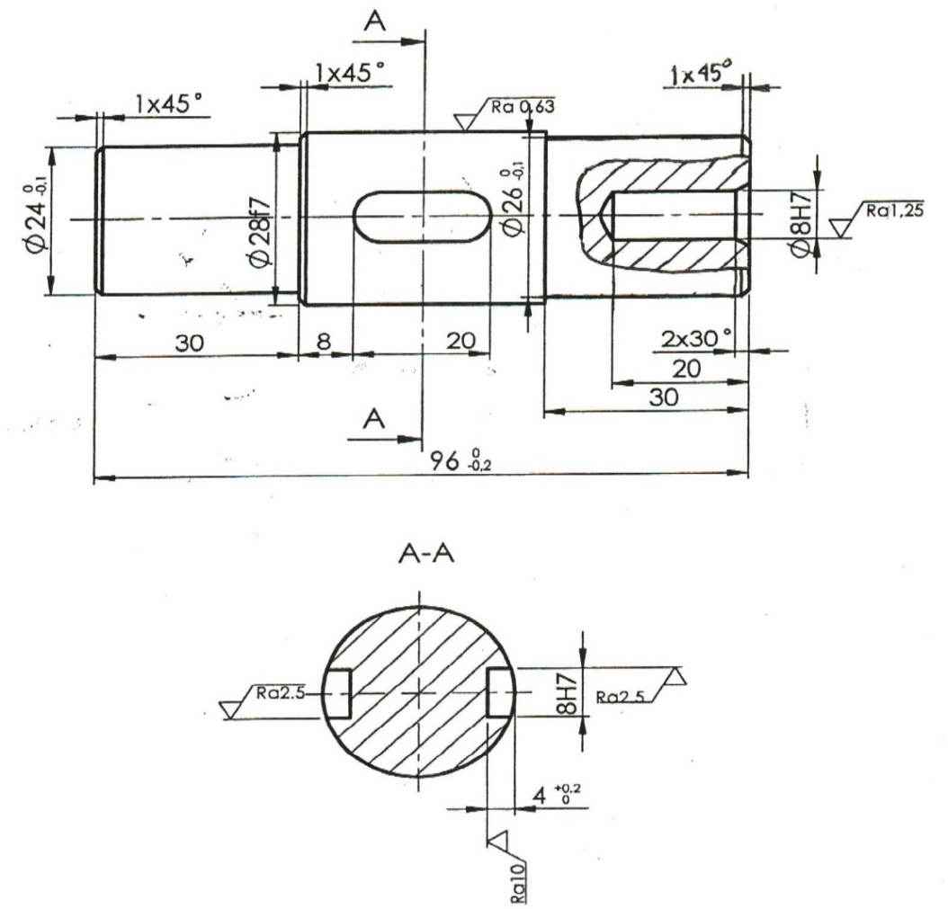
Production task
A. Conventional machine tools
Develop a simplified technological process for a shaft (series production conditions) without heat treatment.
Outliers
Symbols used in the documentation:
Buffer (stop)
Three-jawed handle
Dead centre
Live centre
Driving centre
*
Comparison of conventional and modern CNC technologies
26/80

Slide 27
Production task
10 Turning (Roughing)
Cuts:
1. Facing on length 98_{-0,2}
2. Centering A4 on length12
3. Drilling ø7,8 on length 20
4. Boring ø8H7
5. Turning ø27,2_{-0,4} on length 29,7^{+0,1}
Mounting in three-jaw chuck + stop
Universal lathe LZ 360
Attention!
The diagrams illustrate the location of the planned machining.
In the drawing the shaft should be drawn in the position visible on the machine tool and the dimensions from the machining should be taken into account (allowance left for further machining).
*
Comparison of conventional and modern CNC technologies
27/80

Slide 28
Production task
1. Facing on length 98_{-0,2}
2. Centering A4 on length12
3. Drilling ø7,8 on length 20
4. Boring ø8H7
5. Turning ø27,2_{-0,4} on length 29,7^{+0,1}
*
Comparison of conventional and modern CNC technologies
28/80

Slide 29
Production task
20 Turning (Roughing)
Cuts:
1. Facing on length 96_{-0,2}
2. Centering A2 on length dł.6
3. Turning ø29,5_{-0,5}
4. Turning ø25,2_{-0,4} on length 29,7^{+0,1}
Draw a shaft rotated 180°!
Mounting in three-jaw chuck + live centre
Universal lathe LZ 360
*
Comparison of conventional and modern CNC technologies
29/80

Slide 30
Production task
1. Facing on length 96_{-0,2}
2. Centering A2 on length dł.6
3 Turning ø29,5_{-0,5}
4. Turning ø25,2_{-0,4} on length 29,7^{+0,1}
*
Comparison of conventional and modern CNC technologies
30/80

Slide 31
Production task
30 Turning (Shaping)
Cuts:
1. Turning ø28,3_{-0,1}
2. Turning ø26_{-0,1} on length 30
3. Chamfering 1-45°
Mounting in centres (dead centre + driving centre on the left, live centre on the right
Universal lathe LZ 360
*
Comparison of conventional and modern CNC technologies
31/80

Slide 32
Production task
Changing the mounting before shaping turning
1. Turning ø28,3_{-0,1}
2. Turning ø26_{-0,1} on length 30
3. Chamfering 1-45°
*
Comparison of conventional and modern CNC technologies
32/80

Slide 33
Production task
40 Turning (Shaping)
Cuts:
1. Turning ø24_{-0,1} on length 30
2. Chamfering 1-45°
3. Chamfering 1-45°
Draw a shaft rotated 180°!
Mounting in centres (dead centre + driving centre on the left, live centre on the right)
Universal lathe LZ 360
*
Comparison of conventional and modern CNC technologies
33/80

Slide 34
Production task
1. Turning ø24_{-0,1} on length 30
2. Chamfering 1-45°
3. Chamfering 1-45°
*
Comparison of conventional and modern CNC technologies
34/80

Slide 35
Production task
50 Milling
Cut:
Milling splineway 8H7
with a length of 20 according
to the drawing
Mounting in three-jaw chuck with dead centre support
Universal milling machine FWF 32J2
*
Comparison of conventional and modern CNC technologies
35/80

Slide 36
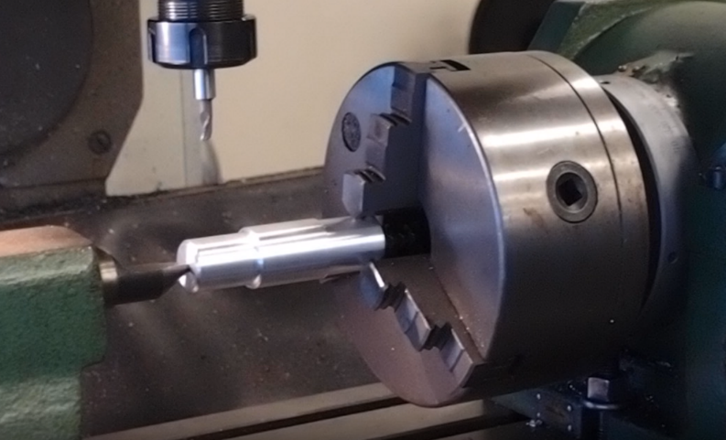
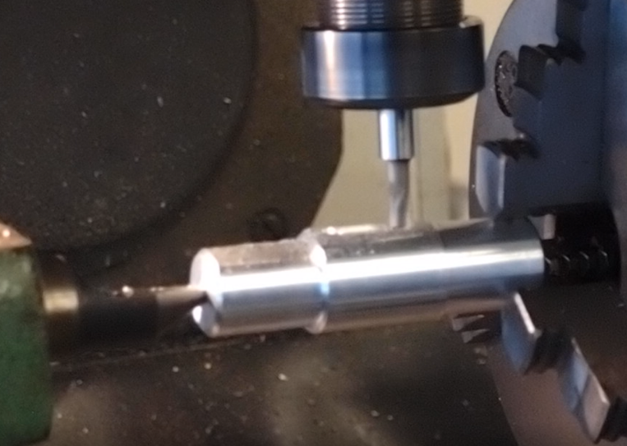
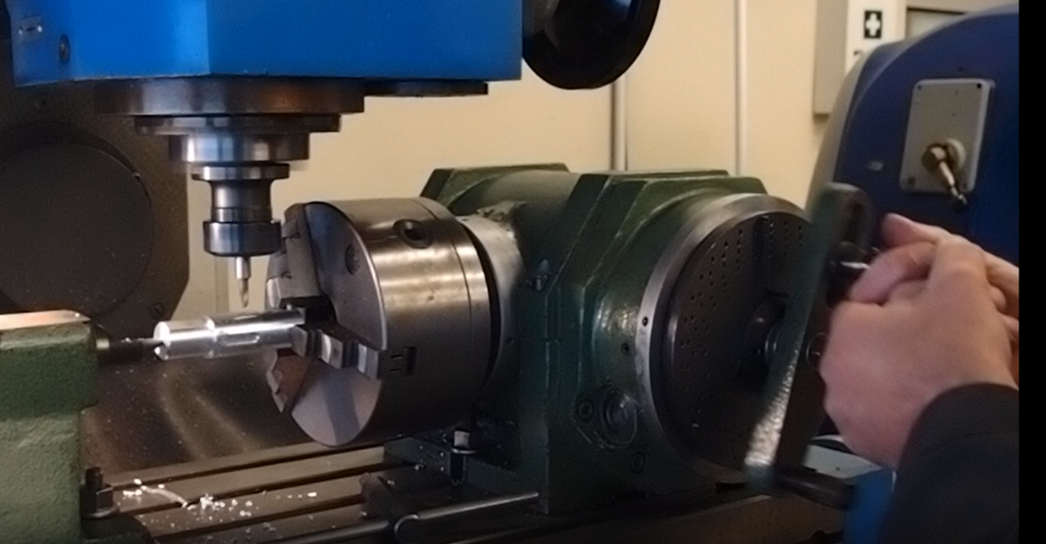
Production task
Mounting in the three-jaw chuck of dividing head
and supporting with a dead centre
Milling the firsth splineway 8H7 with a length of 20
Change of position without unclamping the object
1-cont. Milling the second splineway 8H7 with a length of 20
*
Comparison of conventional and modern CNC technologies
36/80

Slide 37
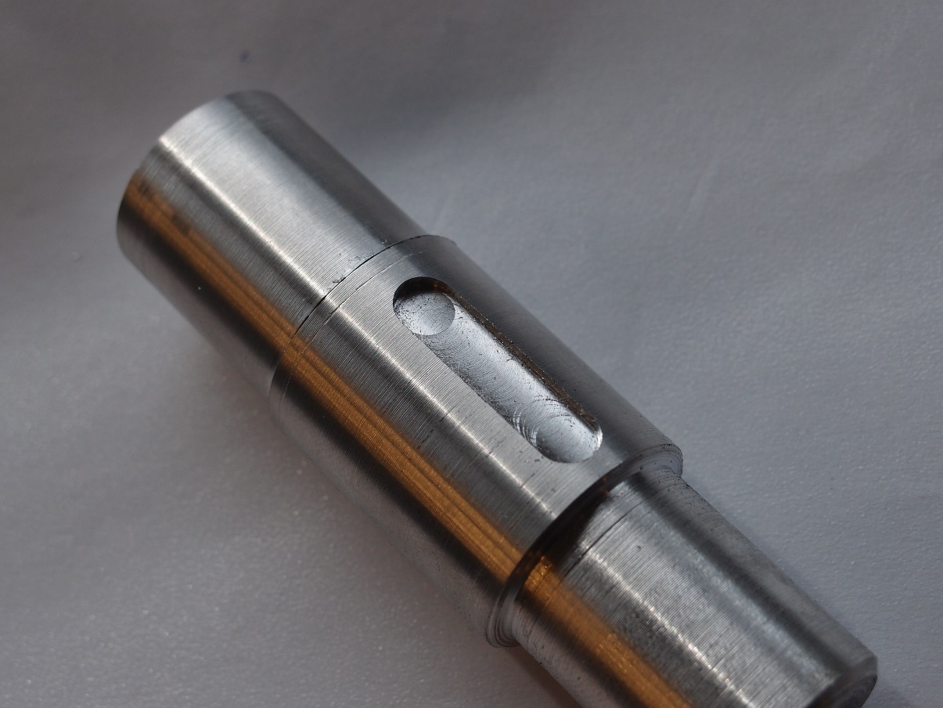
Production task
60 Locksmith
Cut:
1. Blunting sharp edges
Documentation often without drawing
*
Comparison of conventional and modern CNC technologies
37/80

Slide 38
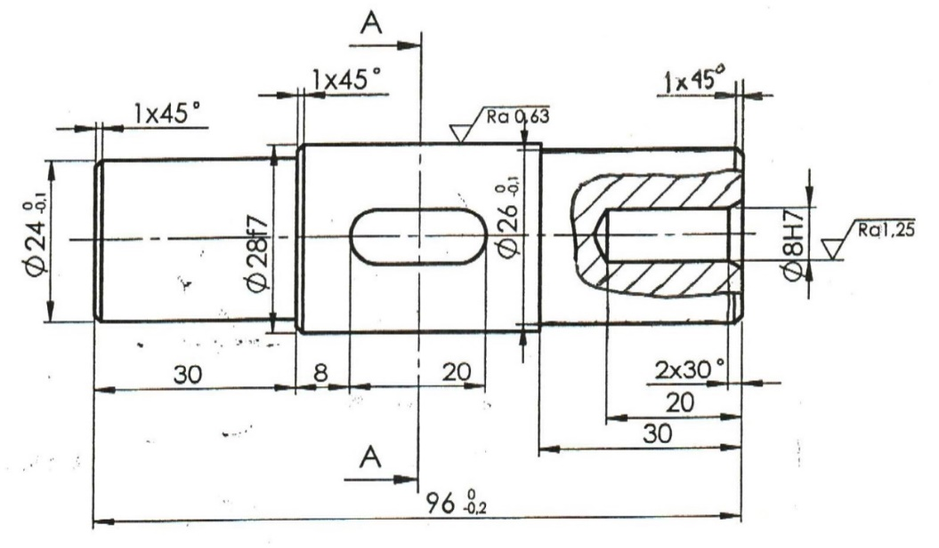
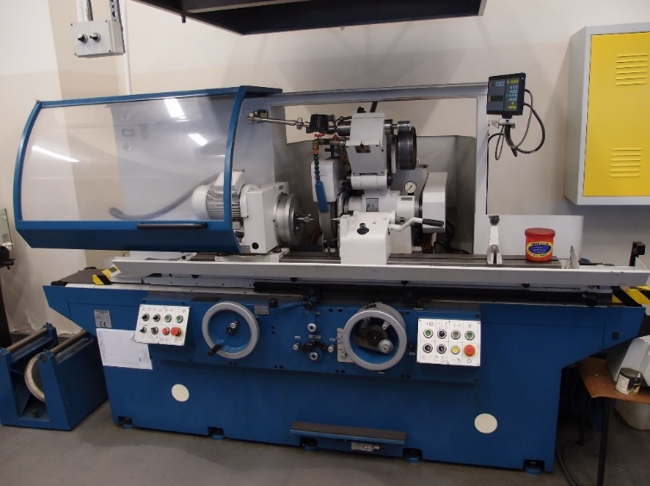
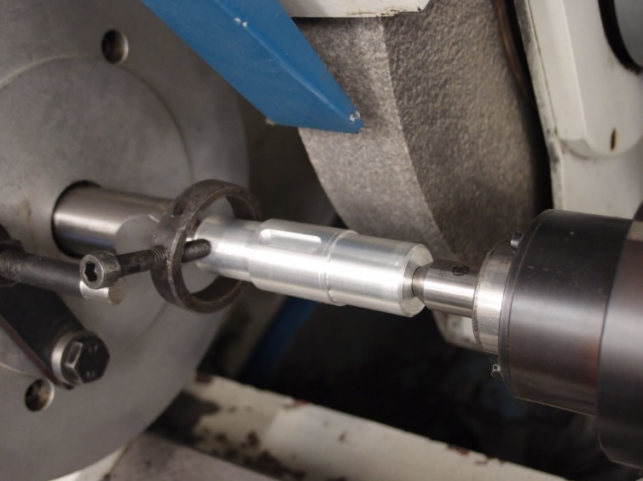
Production task
70 Grinding
Cut:
1. Grinding ø28f7
Clamping in dead centres (+ driving centre)
Universal grinder RUP280
*
Comparison of conventional and modern CNC technologies
38/80

Slide 39
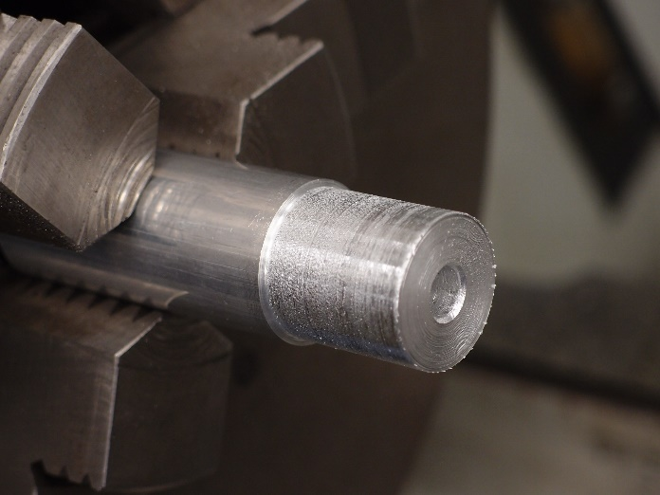
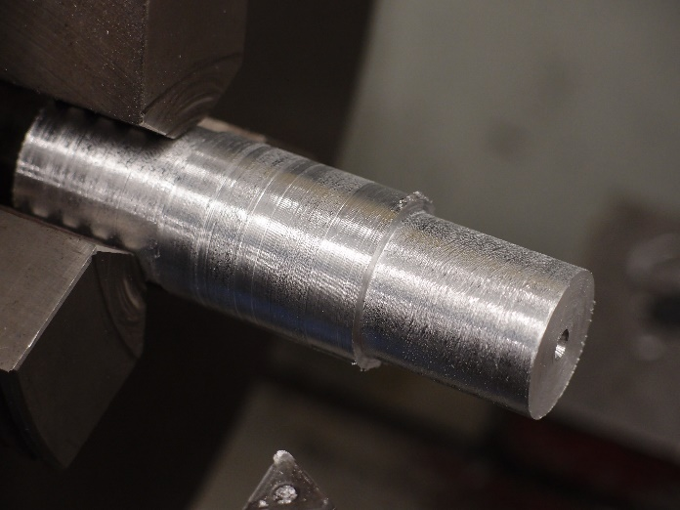
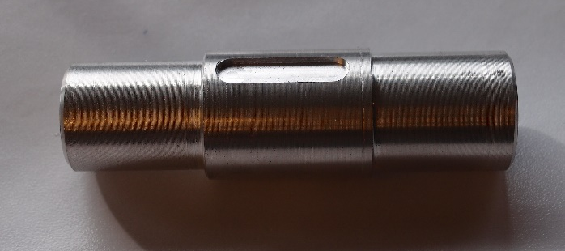
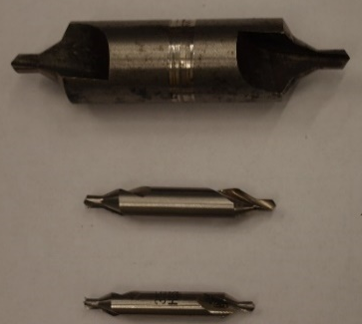
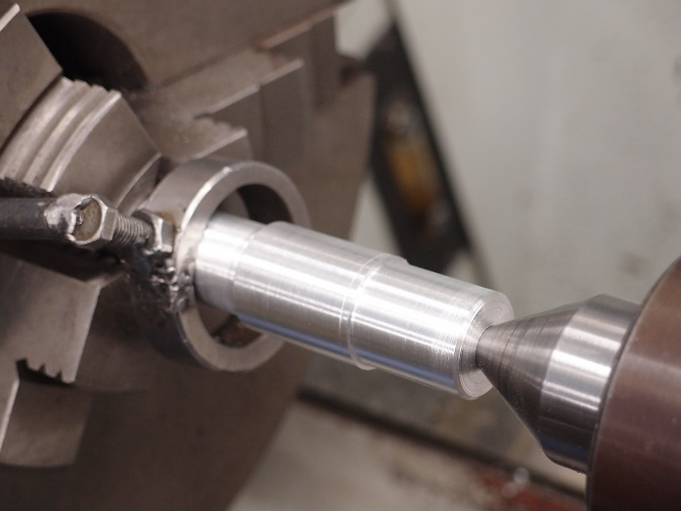
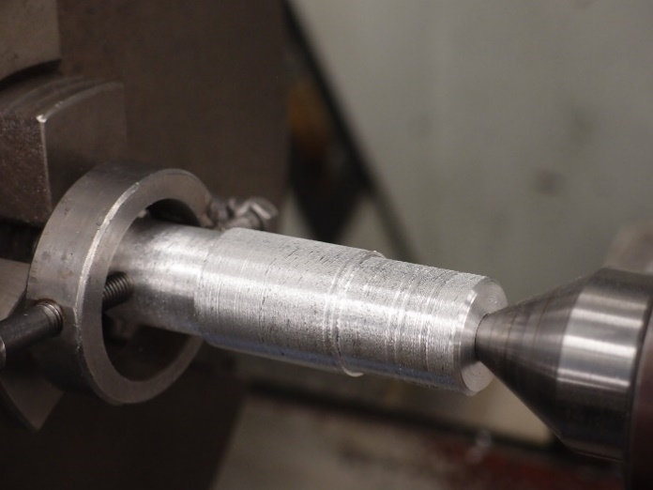
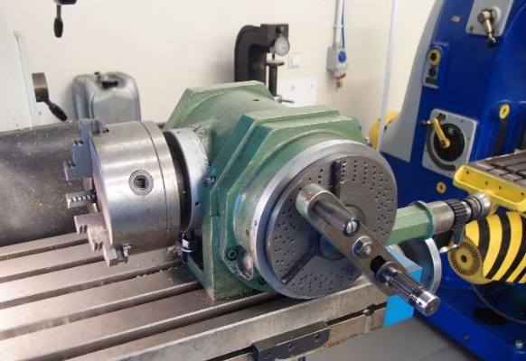
Supplement
Shaft after operations: 50, 60, 70
Shaft after operation 10
Shaft after operation 20
Dividing head
Centre drills
Shaft after operation 30
Shaft after operation 40
*
Comparison of conventional and modern CNC technologies
39/80

Slide 40
Case study 2
Technological process design
Comparative analysis of the use of conventional and CNC machine tools
‹#›
‹#›
Notes:
‹#›

Slide 41
TP design. Comparative analysis of the use of conventional and CNC machine tools: Introduction
Taking into account the conventional method of machining, the time of using the machine tool during the technological operation is approx. 30%.
Most of the time is consumed by auxiliary activities, such as clamping and unfastening the workpiece, moving the tool in and out.
Thanks to automation, these times can be reduced by up to 80%, which improves efficiency, especially with a large production program.
At the turn of the 1940s and 1950s, the first numerical control (NC) machines were created. The principle of their operation was the processing of input data in binary and pulse form into working movements.
The development of technology resulted in further automation in the form of CNC machine tools.
*
Comparison of conventional and modern CNC technologies
41/80

Slide 42
CNC – Computerized Numerical Control
Numerical control systems, equipped with a freely programmable microcomputer, which can be programmed and activated interactively.
The basic functions of CNC systems include:
support for a graphical monitor, which displays NC programs (numerical control), database of tools and cutting parameters, user interfaces, and simulation verifies the correctness of the program operation (visualization of cutting tools and their movement trajectories, and in the case of coordinate measuring machines, location and movement of the measuring head)
integration with other computer systems through typical communication interfaces
correction of the trajectory of the tool movement parameters near corners, machined pockets and sharp edges
*
Comparison of conventional and modern CNC technologies
42/80

Slide 43
CNC – Computerized Numerical Control
Numerical control systems, equipped with a freely programmable microcomputer, which can be programmed and activated interactively.
The basic functions of CNC systems include:
compensation of measurement errors and thermal deformations of the functional systems of the machine tool
coding the position of tools in the magazine and their replacement
creating a machine tool protocol - automatic diagnostics and supervision of the machine tool.
*
Comparison of conventional and modern CNC technologies
43/80

Slide 44
Programming of the CNC machine tools
CNC machine tools can be programmed:
manually - the preparation of the program for machining takes place directly on the machine tool by the operator - for programming the machining of simple parts
machine - where the machining program is written in the form of a specialized symbolic language
CAD / CAM - which allows you to generate the NC code based on the digital model of the object and convert it into the tool path.
*
Comparison of conventional and modern CNC technologies
44/80

Slide 45
Selected features of NC / CNC machine tools
Selected features of NC / CNC machine tools can be classified as follows:
Each axis has its own drive
The speed and feed can be adjusted steplessly
Compact design with closed work space
Automatic tool change from the tool magazine
Automatic item exchange
Automated workpiece measurement
Automatic chip removal
High power and high processing speeds.
*
Comparison of conventional and modern CNC technologies
45/80

Slide 46
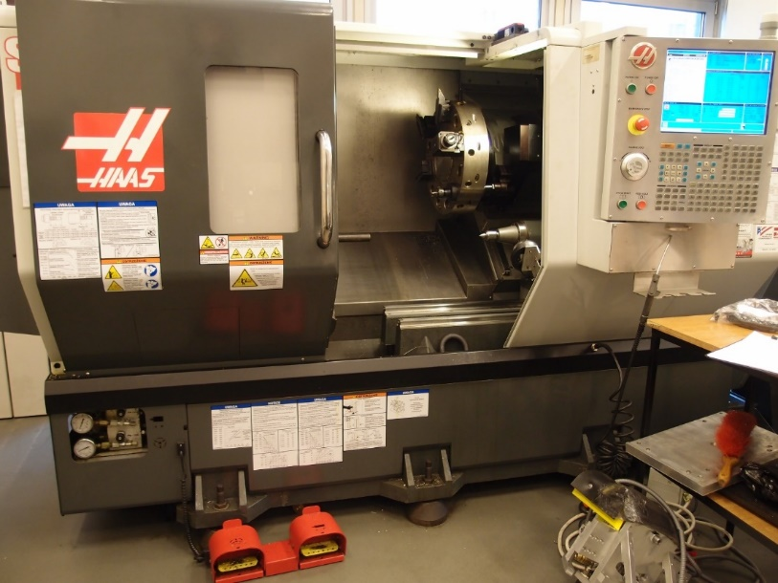
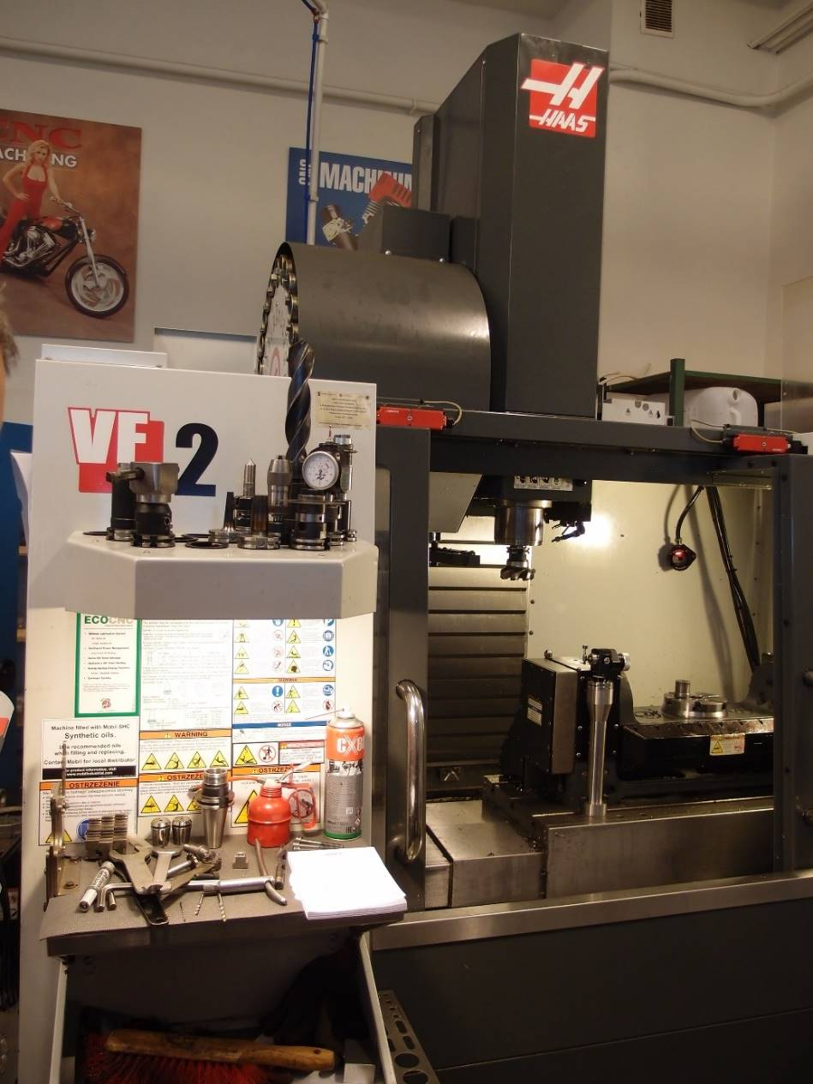
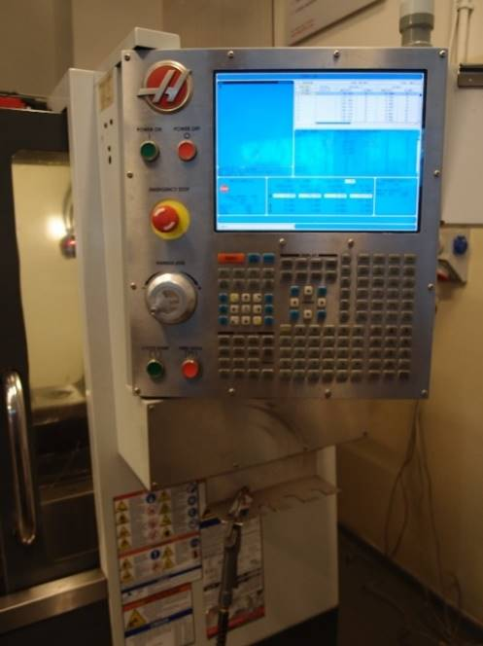
Examples of CNC machine tools
Milling center VF2
ST20 lathe center
*
Comparison of conventional and modern CNC technologies
46/80

Slide 47
Production task B.
Comparative analysis of the use of conventional and CNC machine tools
Part the same like in „Case study 1”
*
Comparison of conventional and modern CNC technologies
47/80

Slide 48
a) input data - conventional
A construction drawing on the basis of which the machining allowances are calculated and the type and dimensions of the semi-finished product are selected.
For the assumed series production, a blank in the form of a rolled bar was selected, at the preparation station the bar was cut into smaller sections taking into account the total length of the shaft and an allowance for machining the fronts.
*
Comparison of conventional and modern CNC technologies
48/80

Slide 49
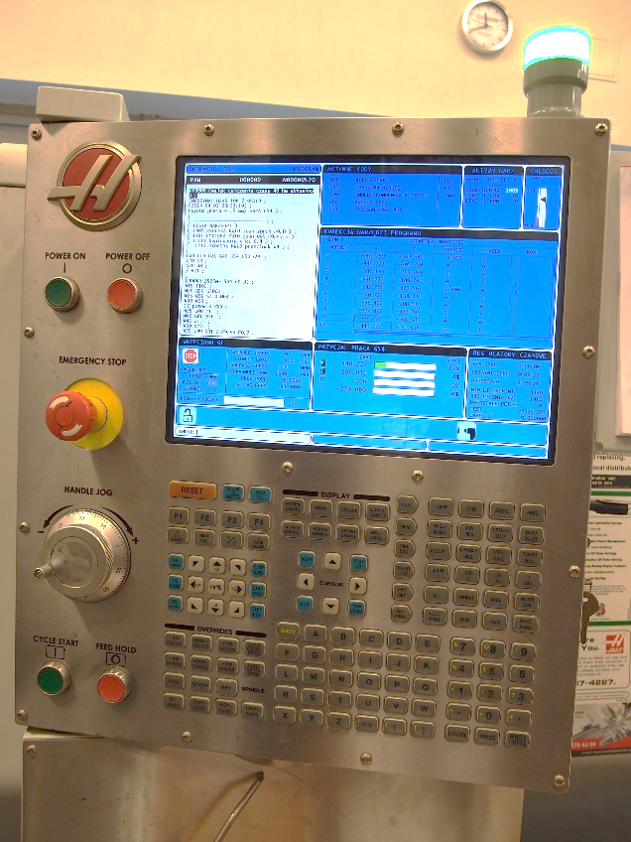
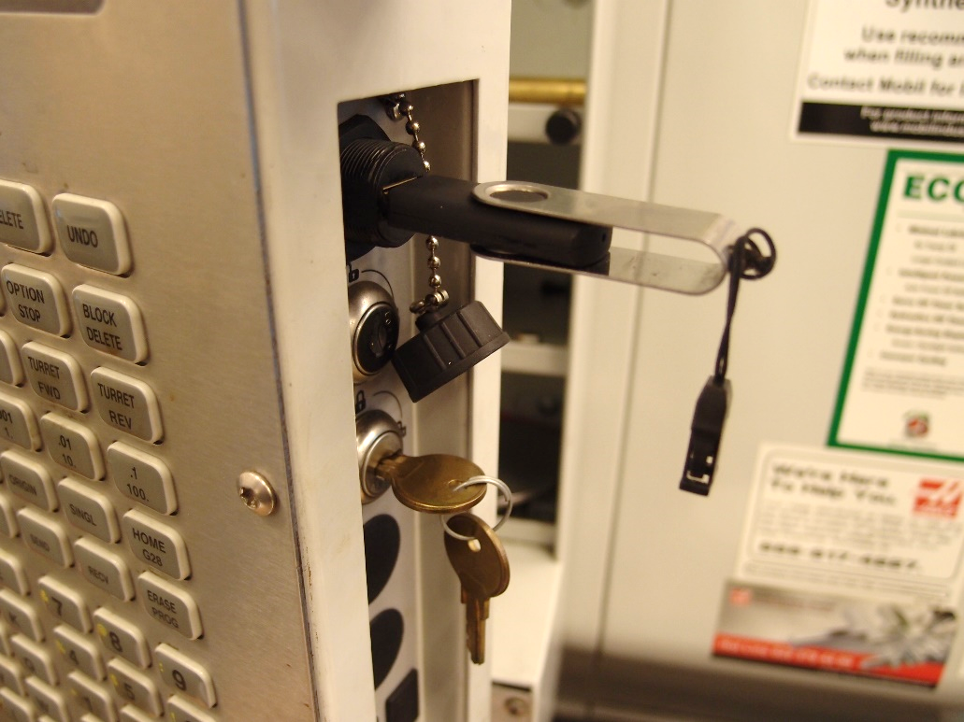
a) input data – modern CNC
The construction drawing is still used to calculate allowances, but it can be loaded directly into the CNC controller and generate a control program, or in other models - generate a control program using the software and load the finished program into the controller.
*
Comparison of conventional and modern CNC technologies
49/80

Slide 50
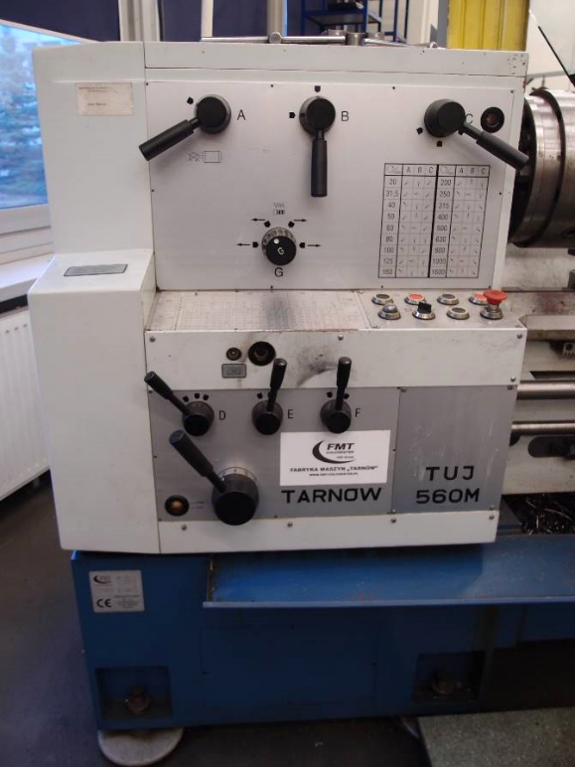
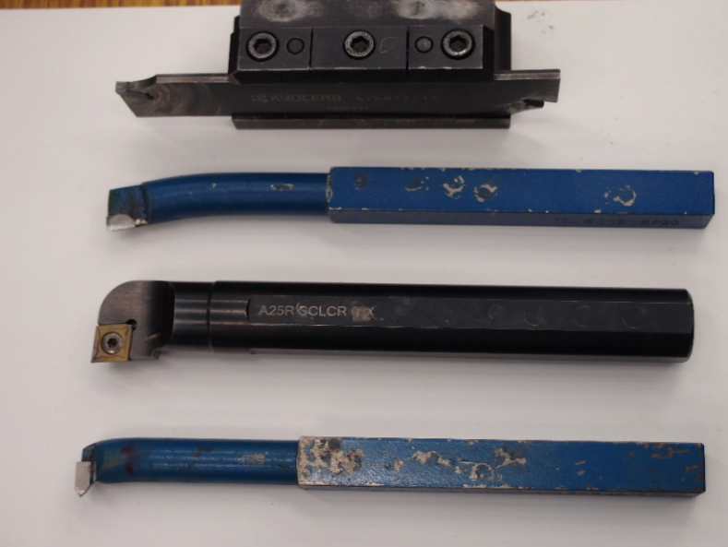
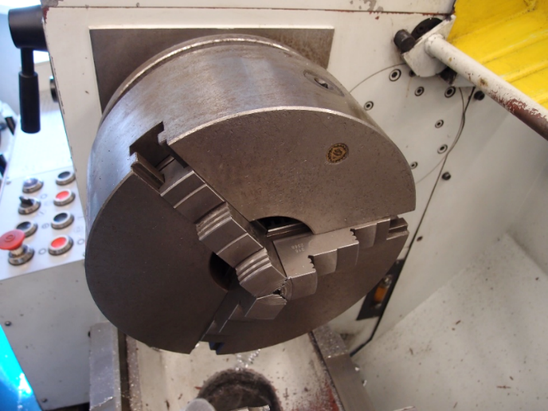
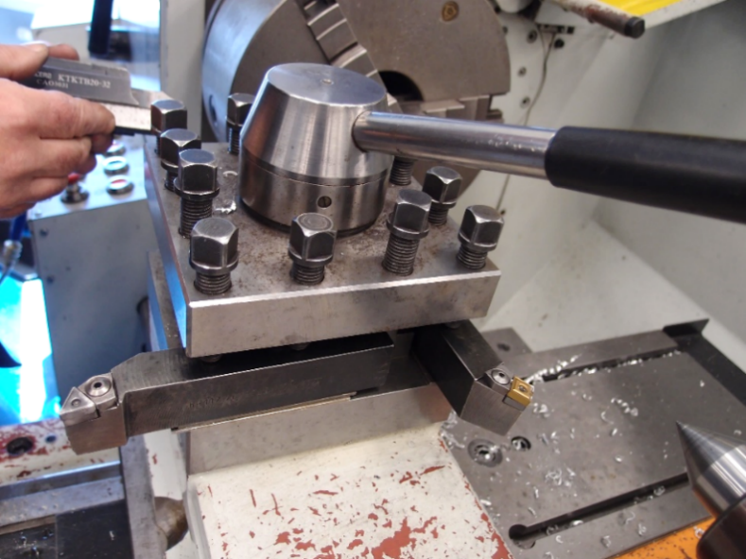
b) set-up, tools and tooling - conventional
Three-jaw chuck Manual clamping
Manual setting
Standard tools, mounted in standard grips
*
Comparison of conventional and modern CNC technologies
50/80

Slide 51
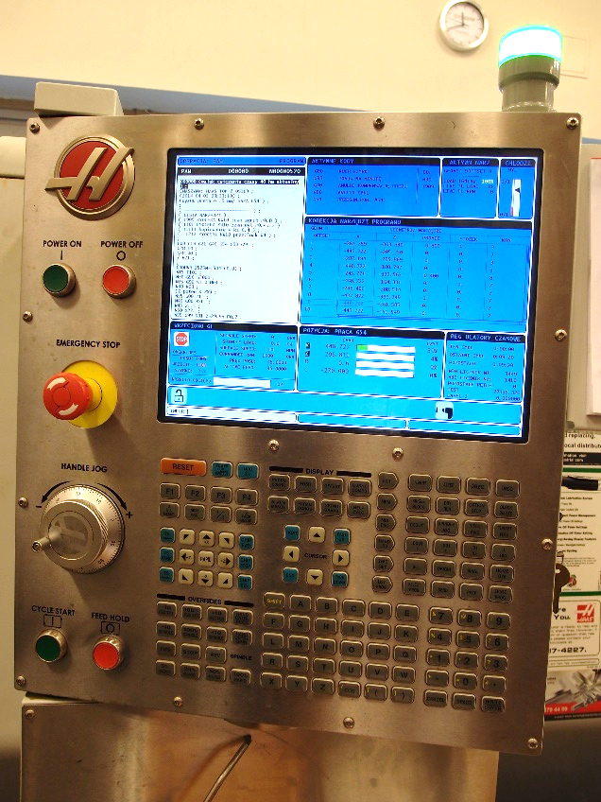
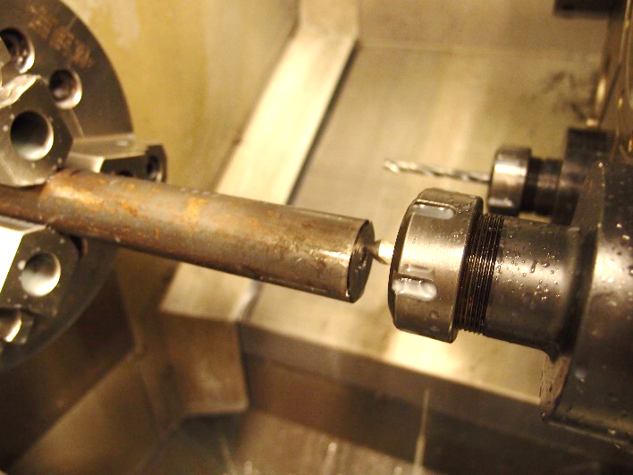
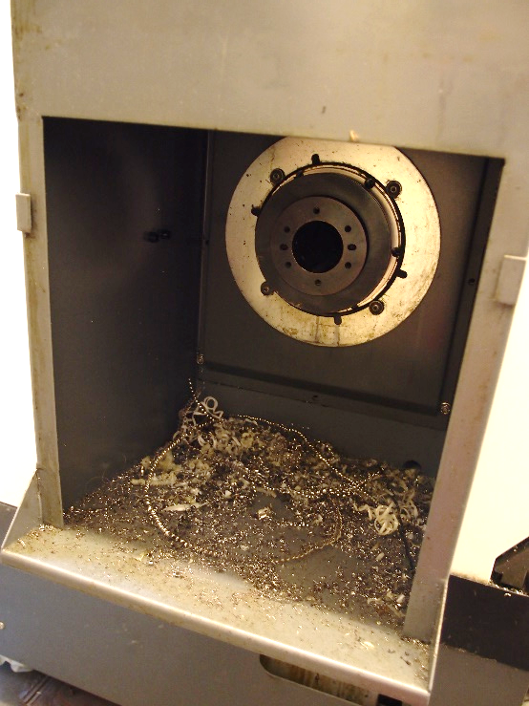
b) set-up, tools and tooling - CNC
A center support required due to the high speeds and cutting forces
The possibility of inserting the entire rod, cutting off the finished piece is programmed as the last treatment
Parameters are set automatically or manually from the desktop
*
Comparison of conventional and modern CNC technologies
51/80

Slide 52
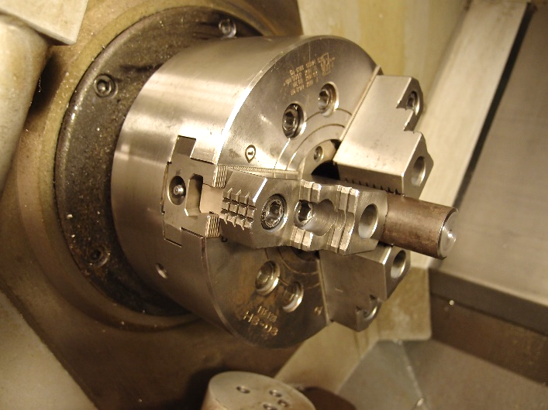
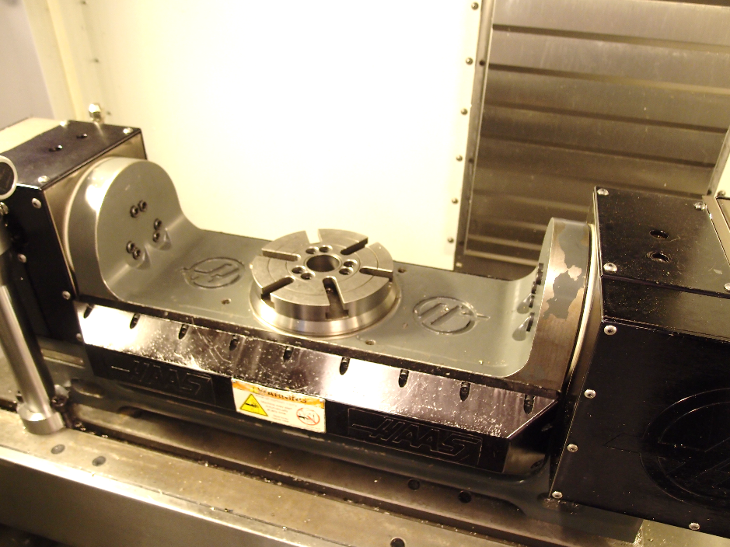
b) set-up, tools and tooling – CNC – cont.
Three-jaw lathe chuck, manual clamping
Milling chuck with 4 or 5 axis control
*
Comparison of conventional and modern CNC technologies
52/80

Slide 53
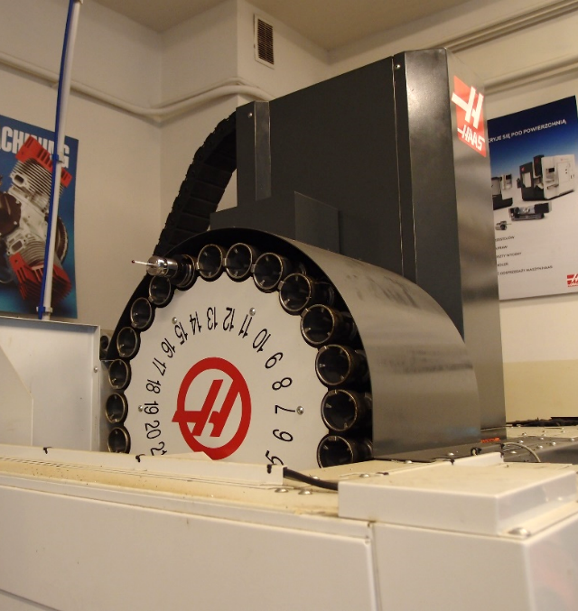
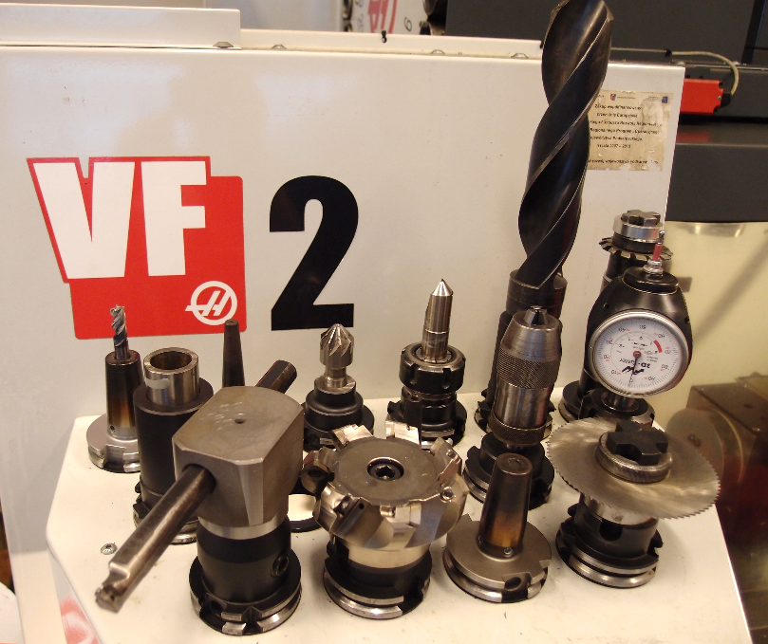
b) set-up, tools and tooling – CNC – cont.
Tool magazines, special holders, the possibility of thermal embedding - milling center
*
Comparison of conventional and modern CNC technologies
53/80

Slide 54
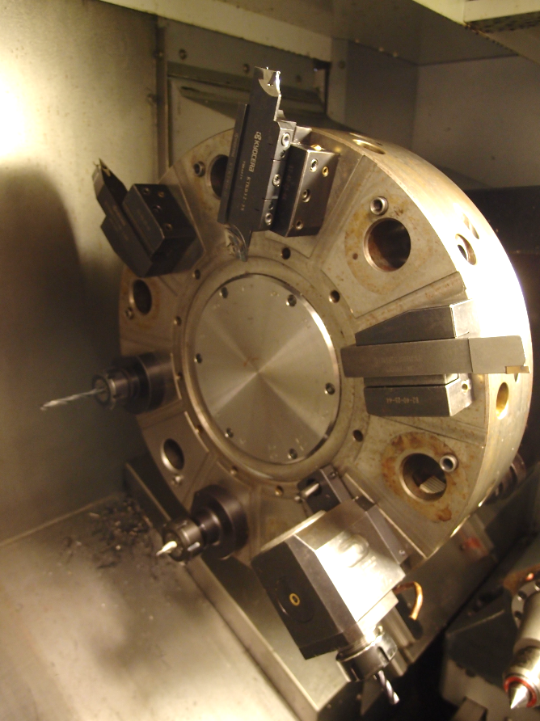
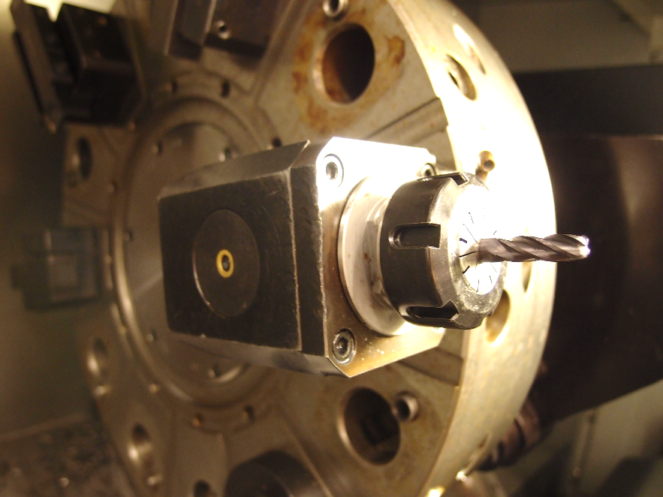
b) set-up, tools and tooling – CNC – cont.
Tool magazines, powered tools (slot milling possibility), automatic tool position measurement - turning center
*
Comparison of conventional and modern CNC technologies
54/80

Slide 55
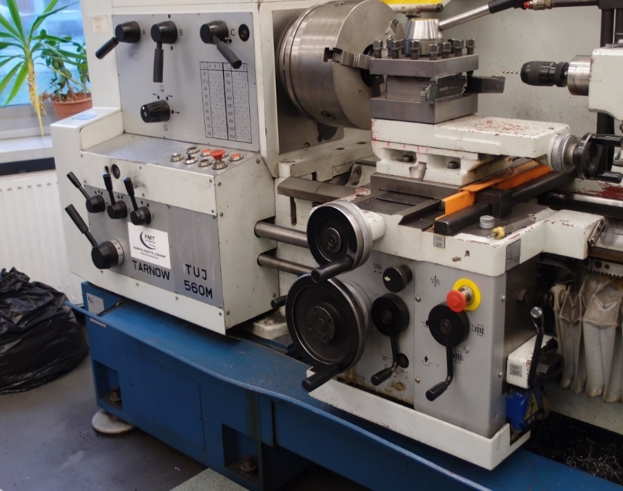
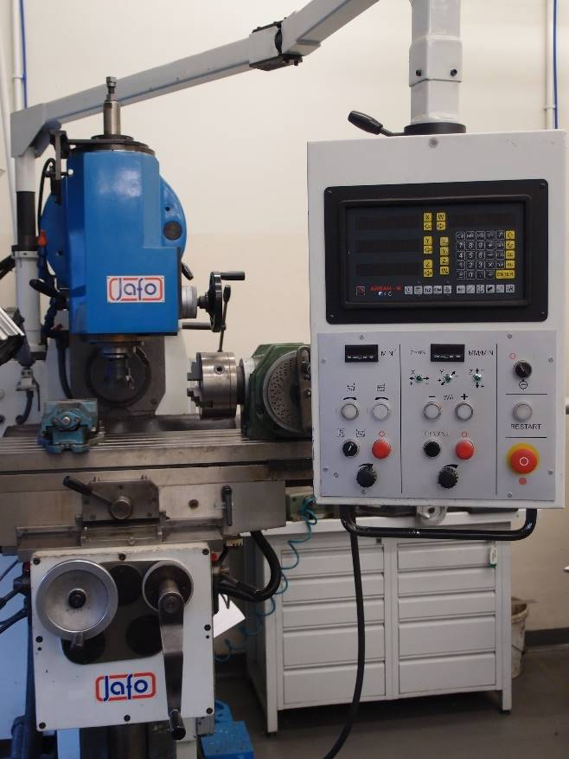
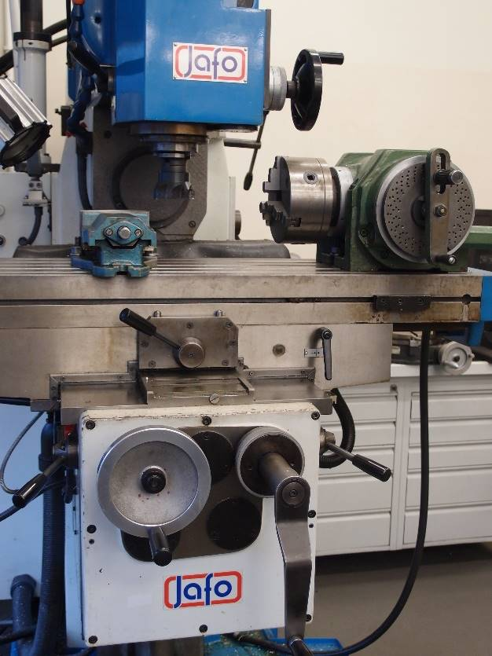
c) control - conventionally
Manual setting of knobs, buttons, levers. Manual control of the operation of the entire machine.
In some cases, an NC control panel is possible (as in the milling machine in the picture - it allows you to control and control the cutting parameters, the movement of the tool relative to the workpiece, but it is not possible to automatically generate the code, use the tool database, etc.)
*
Comparison of conventional and modern CNC technologies
55/80

Slide 56
c) control – modern CNC
The machine control system converts the outline of the workpiece shape into signals that control the mechanisms and drives of the machine.
*
Comparison of conventional and modern CNC technologies
56/80

Slide 57
d) division of the technological process - conventionally
A typical division of the technological process in conventional terms:
- division of operations into roughing, shaping, finishing, ...
- depending on the production volume, process fragmentation - concentrated or diversified organization of operations
elementary and mass - concentrated
serial - diversified
- implementation of tasks according to the capabilities of machine tools and employees: many positions, many employees
- the need to settle machining allowances
*
Comparison of conventional and modern CNC technologies
57/80

Slide 58
d) division of the technological process – modern CNC
A typical technological process in numerical terms:
the workpiece is usually made in 1 operation and 1 mounting
(in conventional – 7 operations, 4 machines, 6 mounting)
- successive tool passes in the program take into account roughing, shaping and finishing (contour)
*
Comparison of conventional and modern CNC technologies
58/80

Slide 59
e) machining accuracy and control
Conventional: accuracy achieved with consecutive processing steps, manual intermediate measurements, final control measuring equipment.
CNC: turned surface - no grinding, no milling (splineways are processing by driven cutter in lathe)
CNC: tool measurements, automatic position correction, measurements, error compensation
Practical example: Dimension measurement ø28: …………………
(
)
28f7
-0,020
-0,041
27,959 ÷ 27,980
*
Comparison of conventional and modern CNC technologies
59/80

Slide 60
e) machining accuracy and control – cont.
CNC: turned surface only - no grinding
Practical example: Surface roughness measurement
Ra = ……….... µm
*
Comparison of conventional and modern CNC technologies
60/80

Slide 61
f) efficiency
Conventionally:
Many operations, need to set up machines, change the fixation of objects and tools, manual setting of parameters, manual measurements, the possibility of making mistakes = extended time
Practical example: Timing
Conventional turning parameters
Rough turning:
rotational speed - 315 rpm.
feed - 0.15 mm / rev
II. Shaping turning:
rotational speed - 500 rpm.
feed - 0.11 mm / rev
*
Comparison of conventional and modern CNC technologies
61/80

Slide 62
Selected features of NC / CNC machine tools
*
Comparison of conventional and modern CNC technologies
62/80

Slide 63
f) efficiency – cont.
High efficiency - higher cutting speeds, tool movement, measuring probe, automatic measurements, a small number of defective items = time savings.
Long Tpz preparation time - program testing and corrections, collision removal, tool magazine loading
?
Tpz = ……. [s]
Σtj = ……... [s]
Turning parameters in a CNC lathe center
I. Rough turning:
rotational speed - 2000 rpm
feed - 0.20 mm / rev.
II. Shaping turning:
rotational speed - 2500 rpm.
feed - 0.07 mm / rev.
*
Comparison of conventional and modern CNC technologies
63/80

Slide 64
e) efficiency – cont.
How to compare the efficiency:
We set the execution time for 1 piece – tj:
tj = Tpz/n + tw
where:
Tpz – preparation and completion time
n – number of pieces in the lot
tj – unit time (for one piece)
tw – execution time (machining + auxiliary time)
A task for those who are interested:
How long will it take to produce 7,500 pieces of shafts under conventional conditions, and how much in a CNC center?
(if preparation and finishing time Tpz for CNC = 2 hours 30 minutes)
*
Comparison of conventional and modern CNC technologies
64/80

Slide 65
Case study 3
Laser cutting of plastics
‹#›
‹#›
Notes:
‹#›

Slide 66
Introduction to the laser technique
Laser – ang. Light Amplification by Stimulated Emission of Radiation
The phenomenon of light amplification is used in many areas of life:
in production:
processing - cutting, welding, surfacing by welding, heat treatment, alloying, engraving, marking, sintering
inspection and engineering works - scanning, counting
in construction
military
medicine
another
*
Comparison of conventional and modern CNC technologies
66/80

Slide 67
Task
Task: Check the possibility of laser cutting of selected plastics
Characteristics of the laser device
Characteristics of the selected type of material
Analysis of cutting results on selected samples
Selection of criteria for assessing the quality of laser cutting
Experimental determination of the optimal variant of cutting
Drawing a nomogram for cutting of selected material for samples of different thickness - a calculation task for students.
*
Comparison of conventional and modern CNC technologies
67/80

Slide 68
Laser plotter
Application for cutting elements from:
Plastics
Wood
Leather
Paper
Textiles
Glass
Laser plotter CO₂ ATMS PRO1390
*
Comparison of conventional and modern CNC technologies
68/80

Slide 69
Cutting tester
Power: 70 W
Wavelength: 10600 nm
Working field : 1300 x 900
Positioning accuracy : ±0,01 mm
Cutting speed 1-200 mm/s
Liquid cooling
Supported image files : dst, plt, bmp dxf
In the cutting tests, a CO₂ laser with a power of 70W and a wavelength of 10.6 µm was used. The device has a focusing lens with a diameter of 20 mm and a focal length of 101.6 mm, and the laser beam is approx. 0.3 mm wide. The controlled parameters were the laser power and the speed of the beam movement in relation to the material surface, the position of the collimation focus was established inside the material and it was a constant value
*
Comparison of conventional and modern CNC technologies
69/80

Slide 70
Control
Control panel on the device
Control program in a computer connected with a USB cable
*
Comparison of conventional and modern CNC technologies
70/80

Slide 71
Characteristics of the polymer
Polypropylene is a thermoplastic transparent material with good impact strength, significant tensile strength, high hardness and rigidity.
It is resistant to water, acids, alcohols, solvents and salt solutions.
The addition of chemically neutral talc to a medium degree improves the compressive strength, increases the modulus of elasticity, reduces thermal expansion, reduces processing shrinkage, increases thermal conductivity, increases electrical resistance and abrasion resistance and rigidity.
It does not change the chemical resistance of the material, while it affects the reduction of product manufacturing costs.
Plates 5 mm thick in both variants were used in the study.
Samples: 1 – polypropylene; 2 – polypropylene + 30% talc
*
Comparison of conventional and modern CNC technologies
71/80

Slide 72
Analysis of the effect of cutting
To determine the best processing variant, the place of cutting was observed. Figures shows the effects of cutting.
Polypropylene
Polypropylene + 30%talc
from the top
off the front
underside
Polypropylene and polypropylene with talc cut at speeds (from left):
20, 25, 30, 35, 40, 45, 50, 55, 60 mm/s at laser power of 35 W
*
Comparison of conventional and modern CNC technologies
72/80

Slide 73
Analysis of the effect of cutting
To determine the best processing variant, the place of cutting was observed. Figures shows the effects of cutting.
Polypropylene
Polypropylene + 30%talc
from the top
off the front
underside
Polypropylene and polypropylene with talc cut at speeds (from left):
20, 25, 30, 35, 40, 45, 50, 55, 60 mm/s at laser power of 52 W
*
Comparison of conventional and modern CNC technologies
73/80

Slide 74
Analysis of the effect of cutting
To determine the best processing variant, the place of cutting was observed. Figures shows the effects of cutting.
Polypropylene
Polypropylene + 30%talc
from the top
off the front
underside
Polypropylene and polypropylene with talc cut at speeds (from left):
20, 25, 30, 35, 40, 45, 50, 55, 60 mm/s at laser power of 70 W
*
Comparison of conventional and modern CNC technologies
74/80

Slide 75
Analysis of the effect of cutting
Analysis of the quality of the incisions made.
In addition to the visual assessment, the width of the slit was also measured.
Quality assessment criteria have been adopted:
I - the material has been cut completely
II - the narrowest gap - optimization of material consumption
III - aesthetics and safety
*
Comparison of conventional and modern CNC technologies
75/80

Slide 76
Processing options and joints widths
Processing options and joints widths (in mm)
*
Comparison of conventional and modern CNC technologies
76/80

Slide 77
Defects in the cutting process
Various cuts classified as defective:
incomplete
resealed
with uneven edges
scorched
with excessive protrusion
distorted
*
Comparison of conventional and modern CNC technologies
77/80
Notes:
‹#›

Slide 78
Cutting speed and material thickness dependence
Determining a nomogram for cutting material of different thickness with a laser of a given power:
Useful cutting speed curve: selected the best option from the experiment sign the speed on Y axis. On X axis sign material thickness.
By selecting the best speed variants for samples of different thickness, a curve is created.
*
Comparison of conventional and modern CNC technologies
78/80

Slide 79
Determination of the cutting speed
From the equation, we determine the constant Q separately for propylene and propylene with talc. Then, by changing the thickness of the laser power, we determine the cutting speed.
*
Comparison of conventional and modern CNC technologies
79/80

Slide 80
THANK YOU FOR YOUR ATTENTION
Comparison of conventional and modern CNC technologies:
complex, hybrid, laser, additive
and other perspectives of research processes
Barbara Ciecińska, Przemysław Podulka Rzeszow University of Technology

